Slide 1

INFORMATION SYSTEM
UNIT 01 : INFORMATION SYSTEM
© 2018, PRAMOD PARAJULI

Slide 2
Disclaimer
These slides are part of teaching materials for Information System (IS). These slides do not cover all aspect of learning IS, nor are these be taken as primary source of information. As the core textbooks and reference books for learning the subject has already been specified and provided to the students, students are encouraged to learn from the original sources.
Contents in these slides are copyrighted to the instructor and authors of original texts where applicable.

Slide 3
INFORMATION SYSTEMS
1.1. Classification and evolution of IS
1.2. Introduction of system development life cycle
1.2.1. Traditional models
1.2.2. Agile methodologies
1.2.3. CASE tools
1.3. Managing Information System project
1.3.1. Project planning – Gantt charts and network diagrams
1.3.2. Software packages for commercial project management
Notes:
Software is not just a product, it’s an experience.

Slide 4
1.1. Classification and evolution of IS
Referneces - - - - - - - - Various

Slide 5
Information Technology & Information Systems
Information System
People
Data
Software
Hardware
Communication

Slide 6
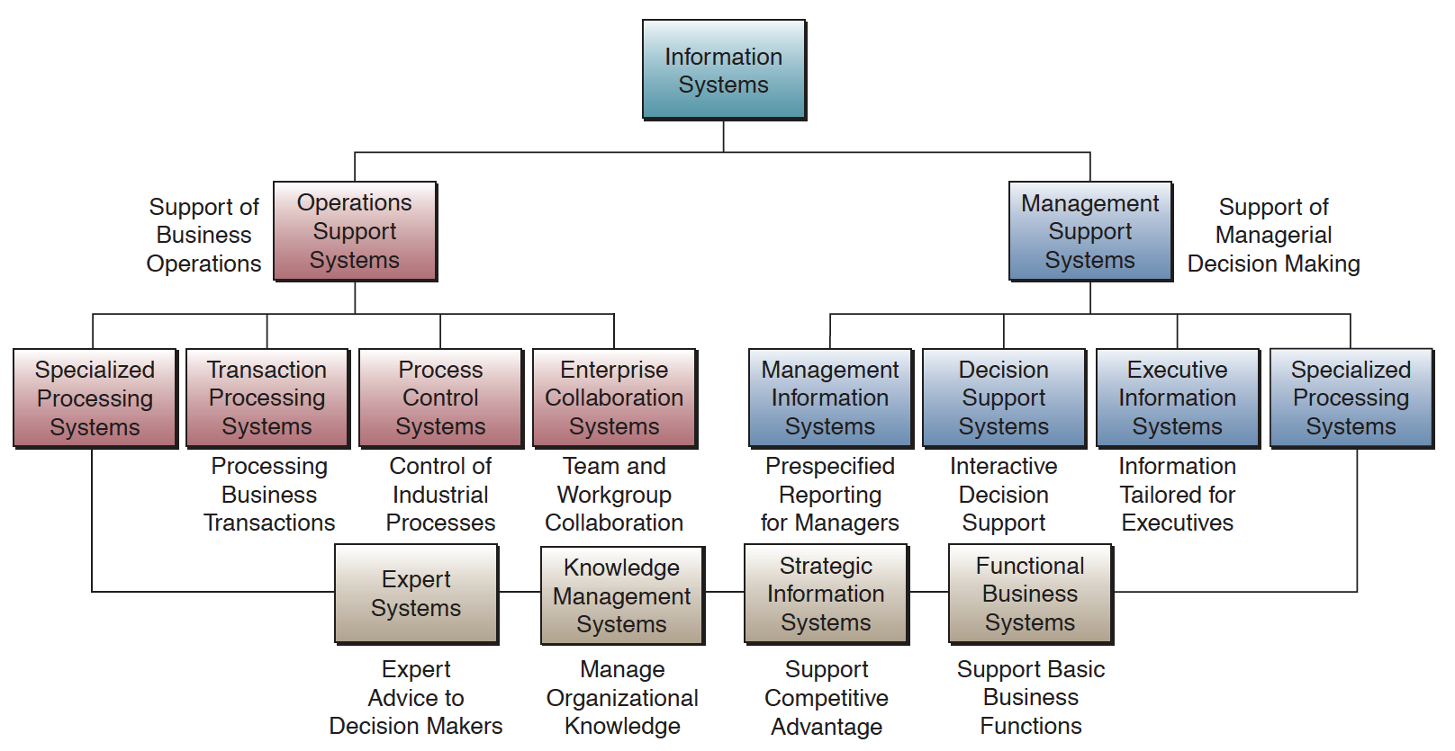
Types of Information Systems
Notes:
Operation support systems: Information systems that process data generated by and used in business operations. The goal of these systems is to efficiently process business transactions, control industrial processes, support enterprise communications and collaboration, and update corporate databases.
Management support systems: Information systems that focus on providing information and support for effective decision making by managers
Specialized processing systems - Dedicated to specific business process
Knowledge management systems: manage organisational knowledge by creating, organising, dissiminating knowledge about business, skill and know-hows.
Expert systems: provide expert insights and decision-support to specific problem areas e.g. customer support, fault detection etc.
Strategic information systems: apply organisational knowledge to find out strategic advantage
Functional business systems: support basic business operations

Slide 7
EVOLUTION OF IS
1950-1960 | 1960-1970 | 1970-1980 | 1980-1990 | 1990-2000 | 2000-
Data Processing | Management Reporting | Decision Support | Executive Support | Knowledge Management | E-Business
Collects, stores, modifies and retrieve day-to-day transactions of an organization | Pre-specified reports and displays to support business decision-making | Interactive ad-hoc support for the decision-making process | Provide both internal and external information relevant to the strategic goals of the organization | Supports the creation, organization and dissemination of business knowledge | Greater connectivity, higher level of integration across applications
Operational staff | Middle managers/line managers | Senior managers | Executives | Enterprise-wide | Global e-Business

Slide 8

Latest trends
Mobile-commerce
Ubiquitous computing
Cloud computing
Wearable computing
Multi-channel & stream processing
Cognitive computing

Slide 9
PLATFORMS
Distributed computing
Micro-services and containers
Mesh computing, software defined networks
AI driven workflows, machine learning for behavioral tracking

Slide 10
Information Systems Projects

Slide 11
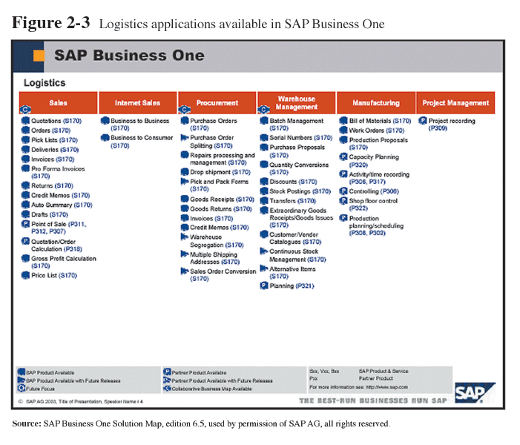
ERP System Example

Slide 12
A typical information system acquisition process
RFP call
Vendor presentations, interactions, negotiations
Tender application
Detailed presentations, demo
Technical evaluation, financial evaluation (may include multiple rounds of negotiation on RFP requirements and financial terms)
Vendor selection

Slide 13
A typical information system acquisition process
Requirements to Analysis models
Data models, process models
Make-buy decisions, reuse
Development
Testing, UAT
Deployment
Maintenance and support

Slide 14
1.2. System Development Life Cycle
References - - - - - - - - Computer Information Systems Management, San-yun W. (Nancy) Tsai, California State University
http://www.csus.edu/indiv/t/tsain/

Slide 15
Agenda
Systems Development Concepts
Challenges in Systems Development
Types of System Development Methods
Systems Development Life Cycle (SDLC)
Rapid Application Development (RAD)
Object Oriented Development (OOD)
Extreme Programming (EP)

Slide 16
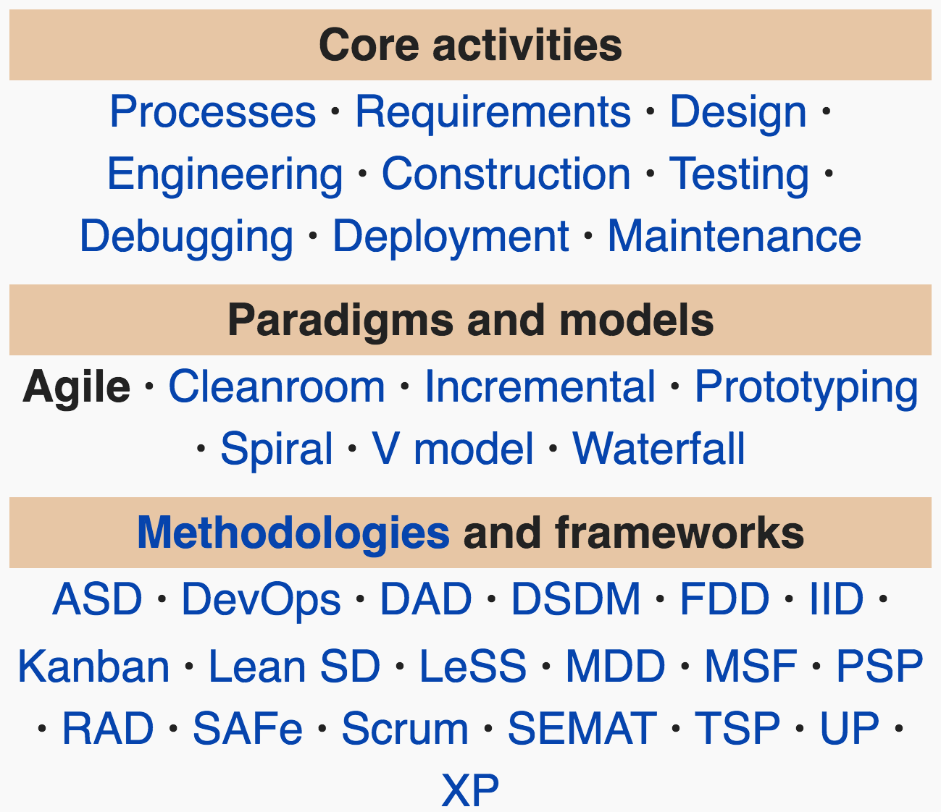
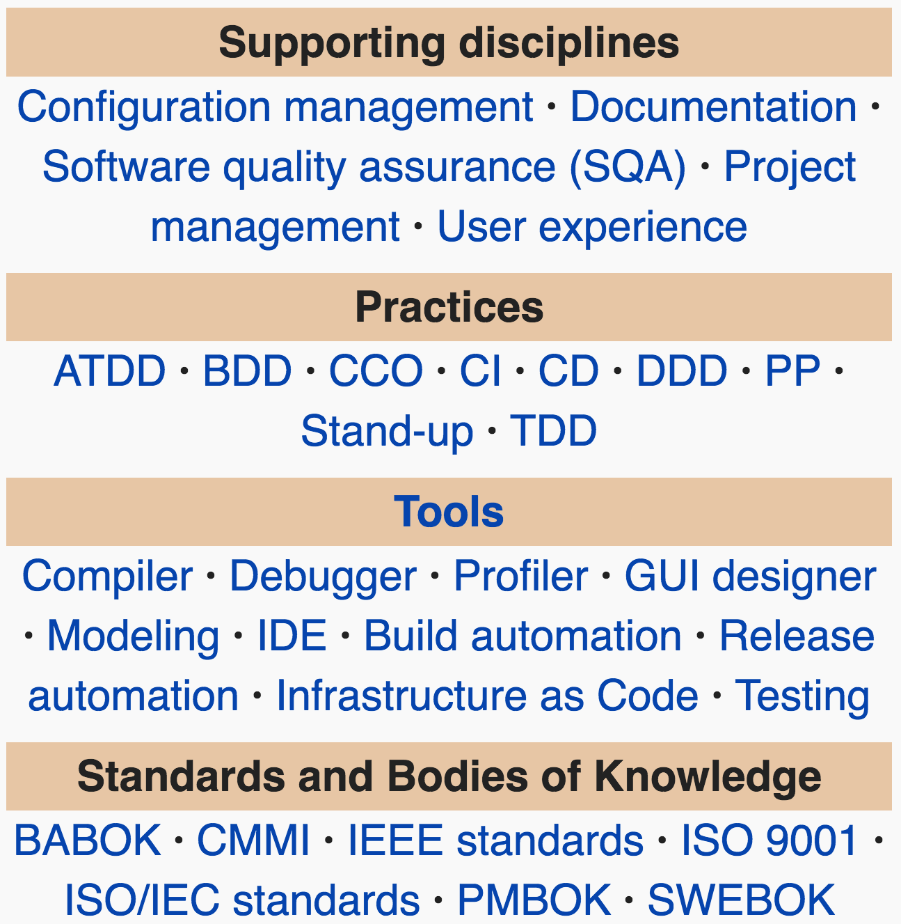
Source: wikipedia.org

Slide 17
System development Life cycle
Conceptualisation
...
Decommissioning

Slide 18
System development Life cycle
Specification
Development
Integration and testing
Deployment

Slide 19
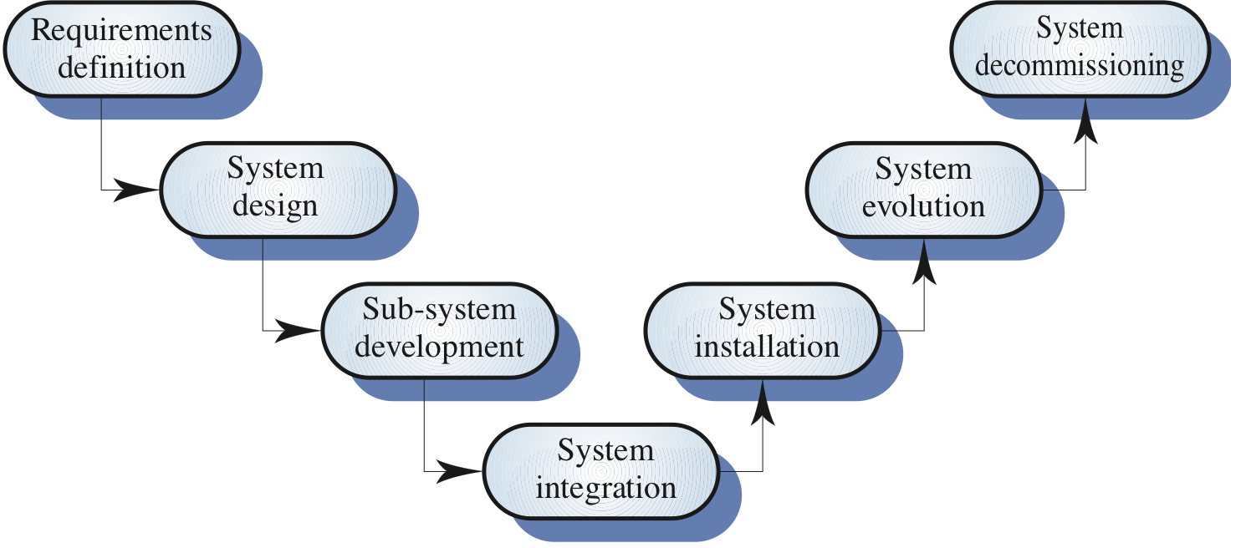
Software process model

Slide 20
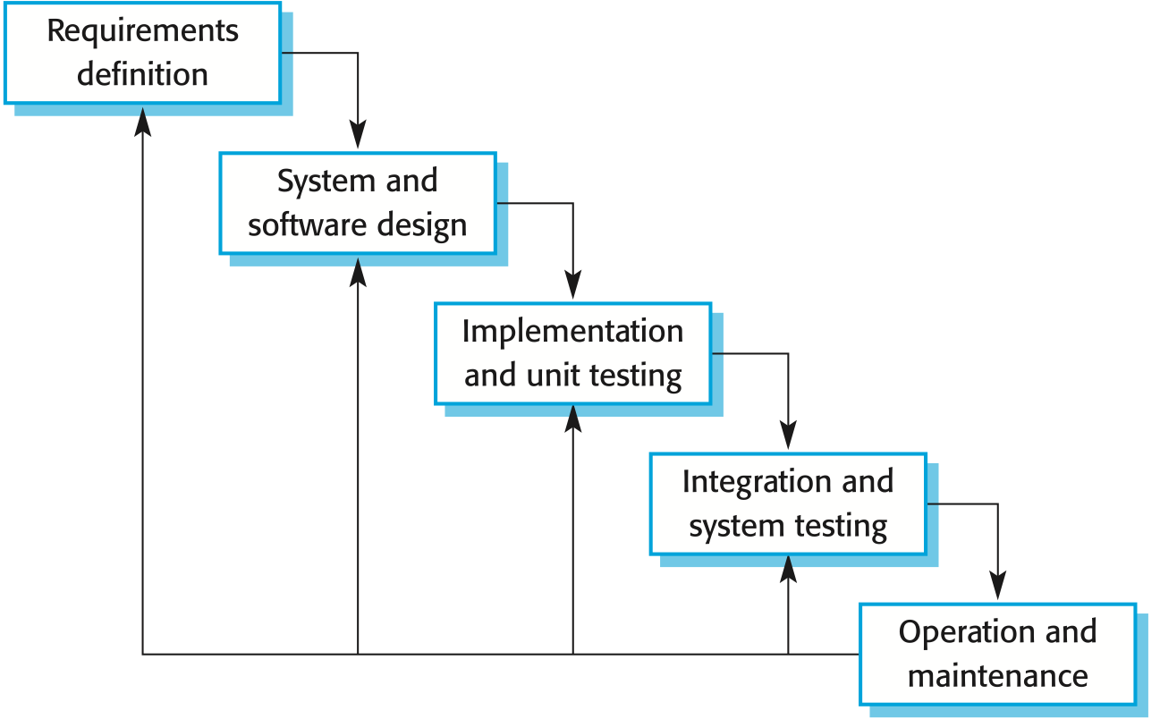
Waterfall model
Notes:
The main drawback of the waterfall model is the difficulty of accommodating change after the process is underway. One phase has to be complete before moving onto the next phase.
Inflexible partitioning of the project into distinct stages makes it difficult to respond to changing customer requirements.
Therefore, this model is only appropriate when the requirements are well-understood and changes will be fairly limited during the design process.

Slide 21
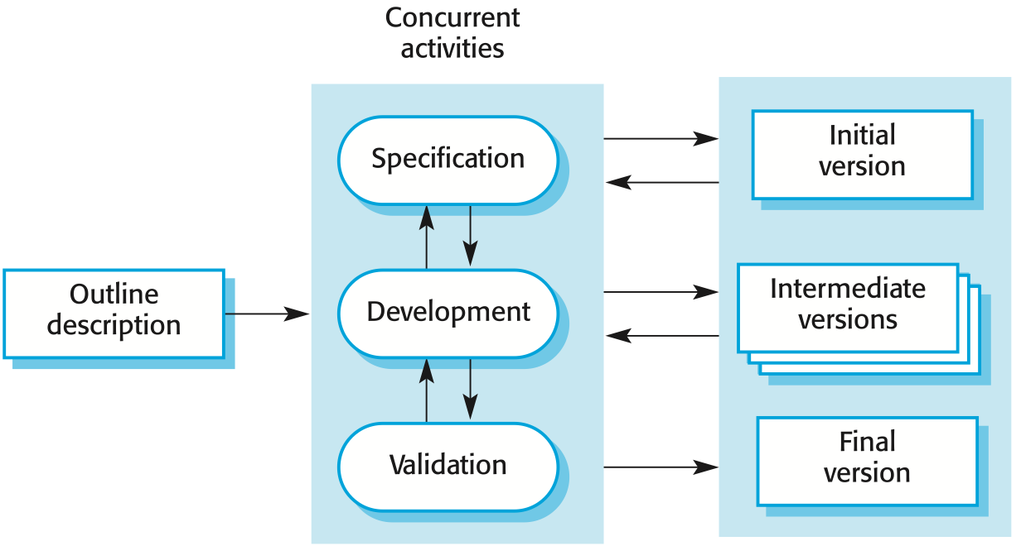
EVOLUTIONARY MODEL
Notes:
Expose initial development to customer them refine through many versions.
Exploratory development - Objective is to work with customers and to evolve a final system from an initial outline specification. Should start with well-understood requirements and add new features as proposed by the customer.
Throw-away prototyping - Objective is to understand the system requirements. Should start with poorly understood requirements to clarify what is really needed.
Problems
Lack of process visibility;
Systems are often poorly structured;
Special skills (e.g. in languages for rapid prototyping) may be required.
Applicability
For small or medium-size interactive systems;
For parts of large systems (e.g. the user interface);
For short-lifetime systems.

Slide 22
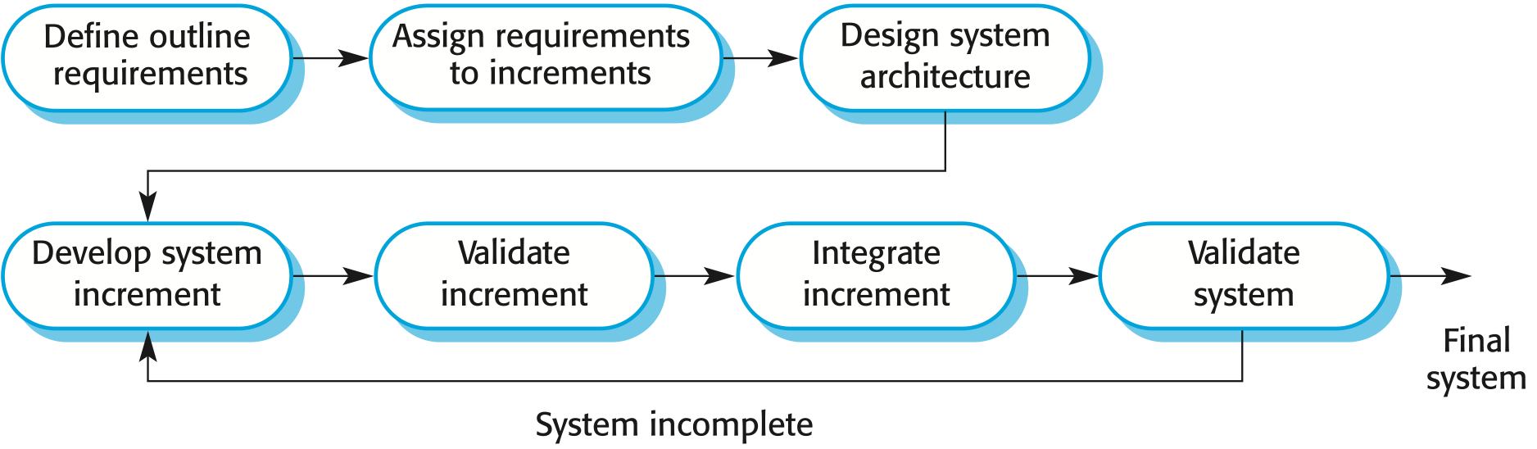
Incremental MODEL
Notes:
First increment – core product, addresses basic requirements
Focuses on ‘operational product’ after each increment unlike prototyping
Used for all ‘agile’ process

Slide 23
PROTOTYPING MODEL

Slide 24
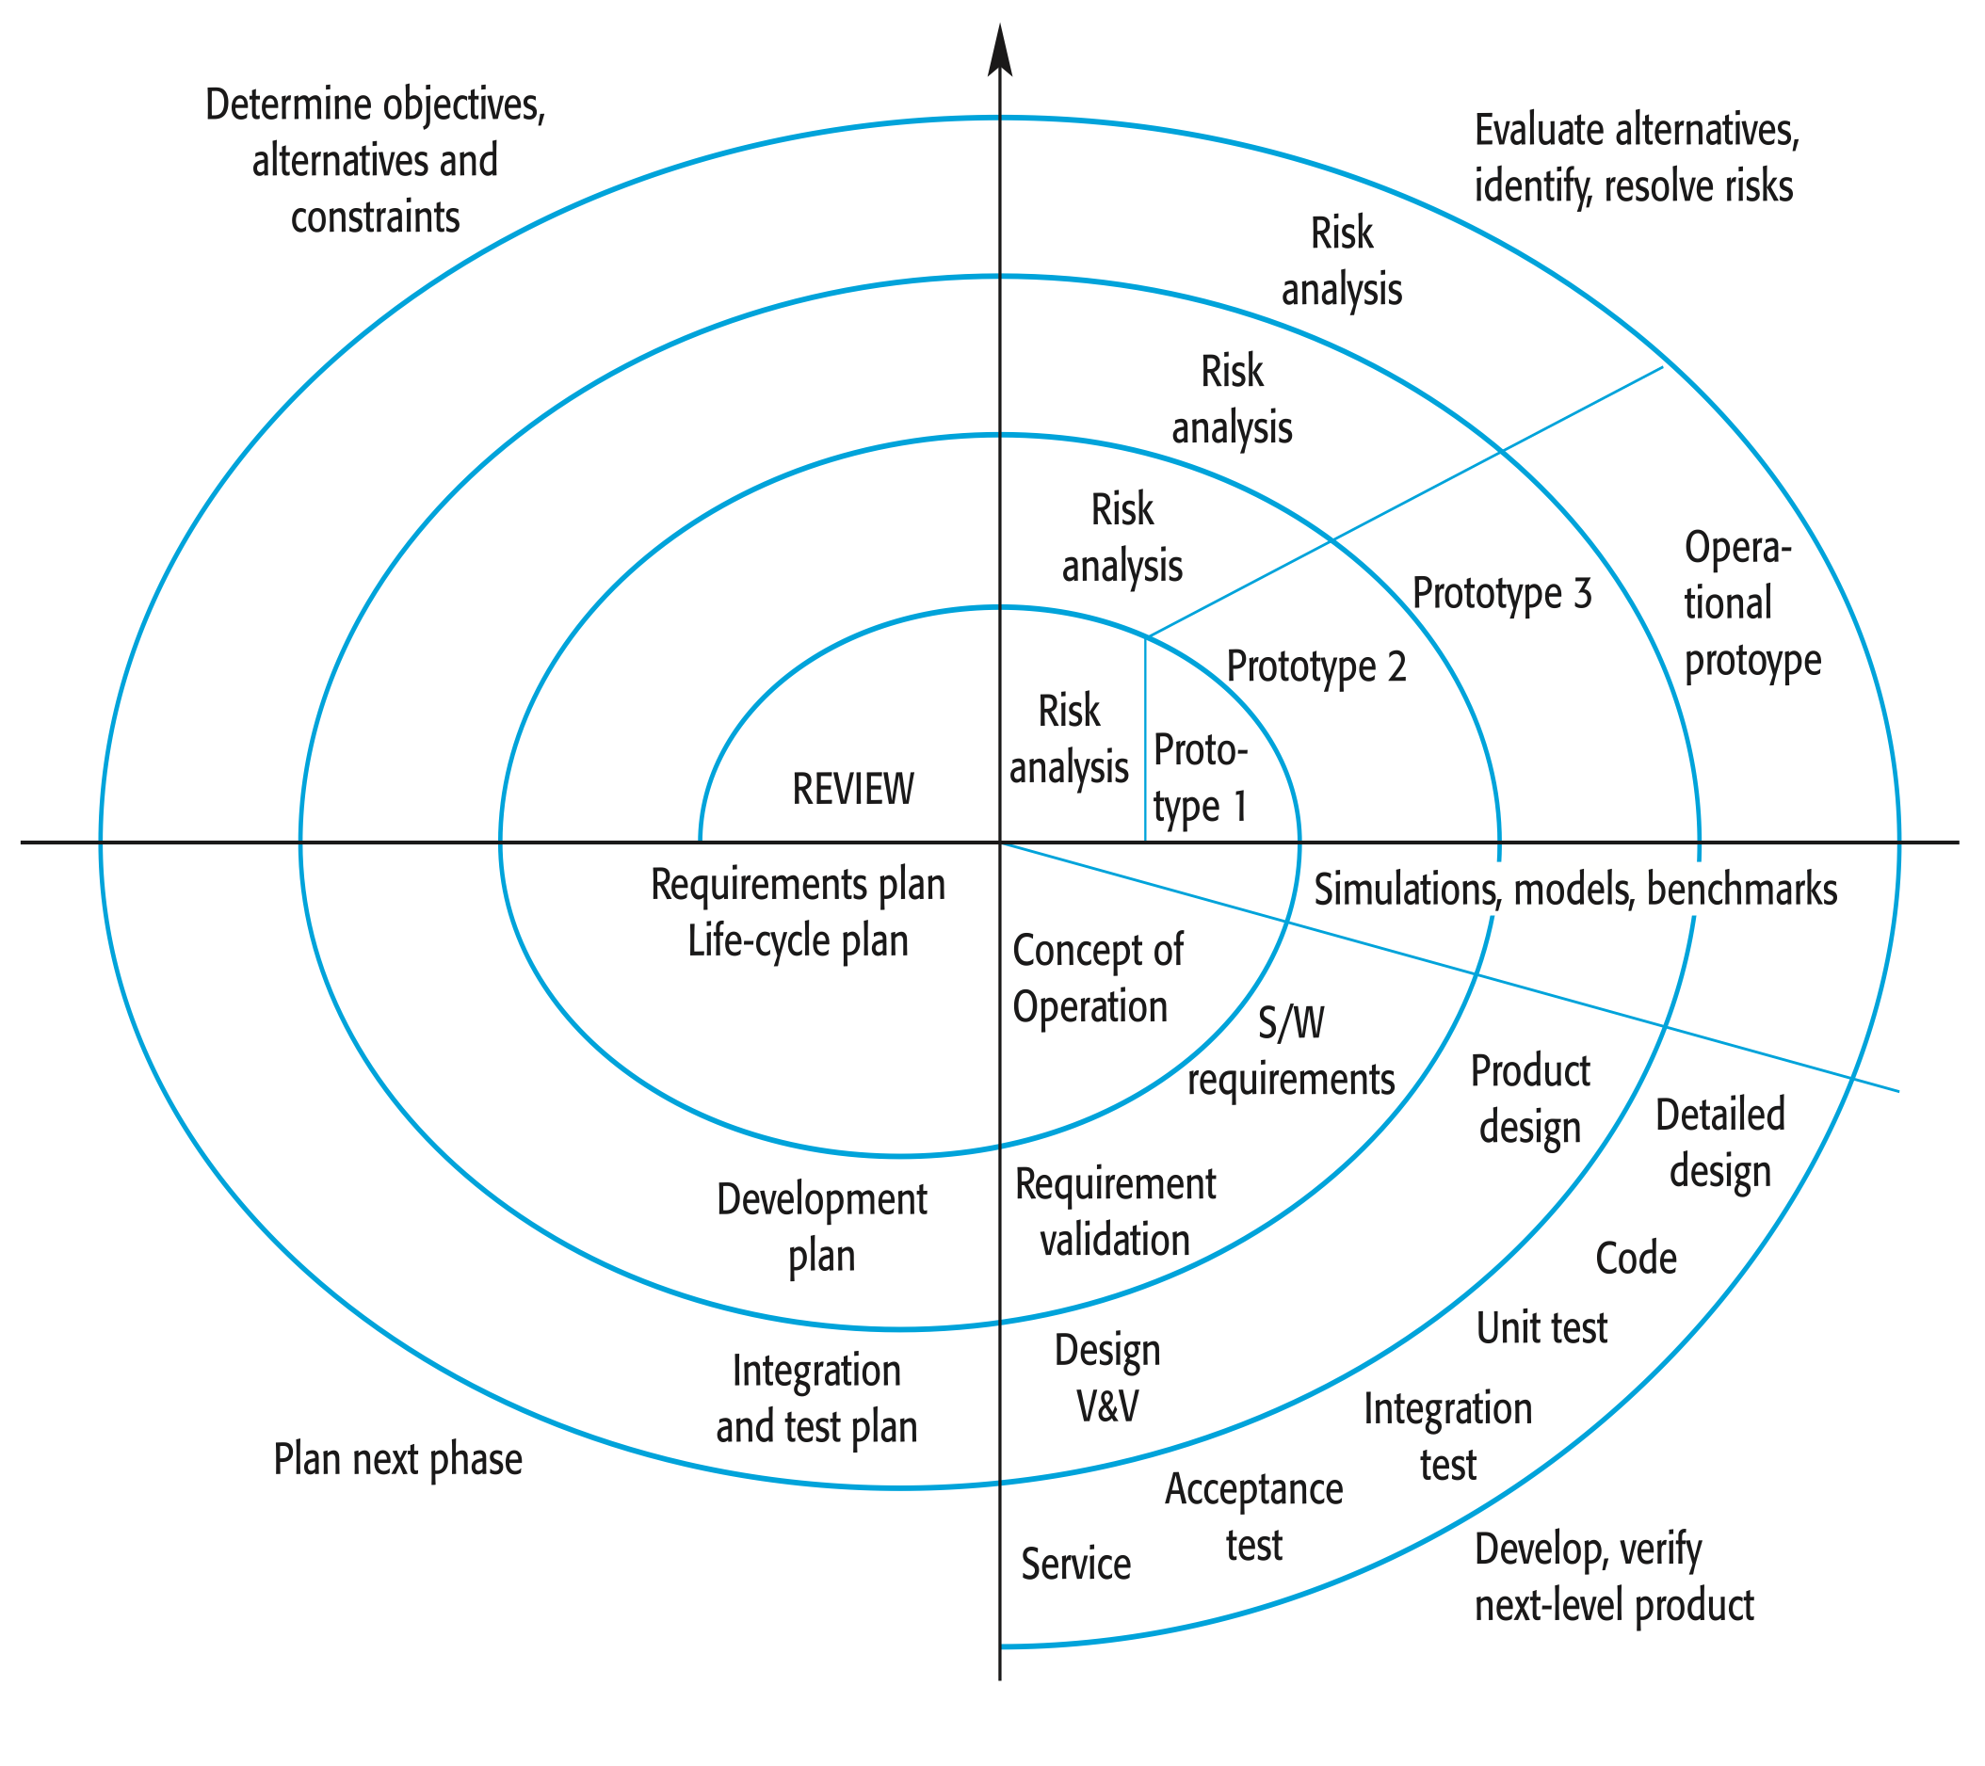
SPIRAL MODEL
Notes:
Customer communication
Planning (estimation, scheduling, risk analysis)
Modeling (analysis, design)
Construction (code, test)
Deployment (delivery, feedback)
(Ref. http://www.sei.cmu.edu/cbs/spiral2000/ )

Slide 25
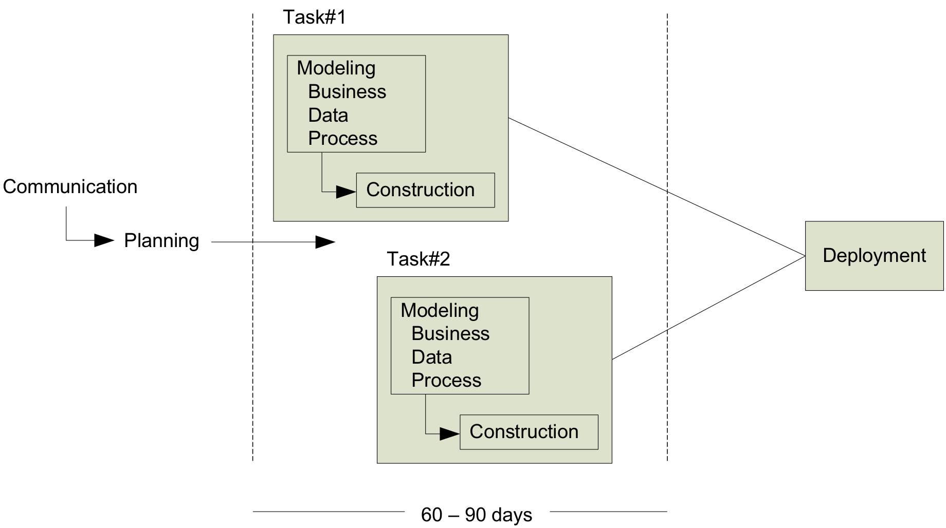
RAD MODEL
Notes:
Incremental S/W process emphasizing on short development cycle

Slide 26
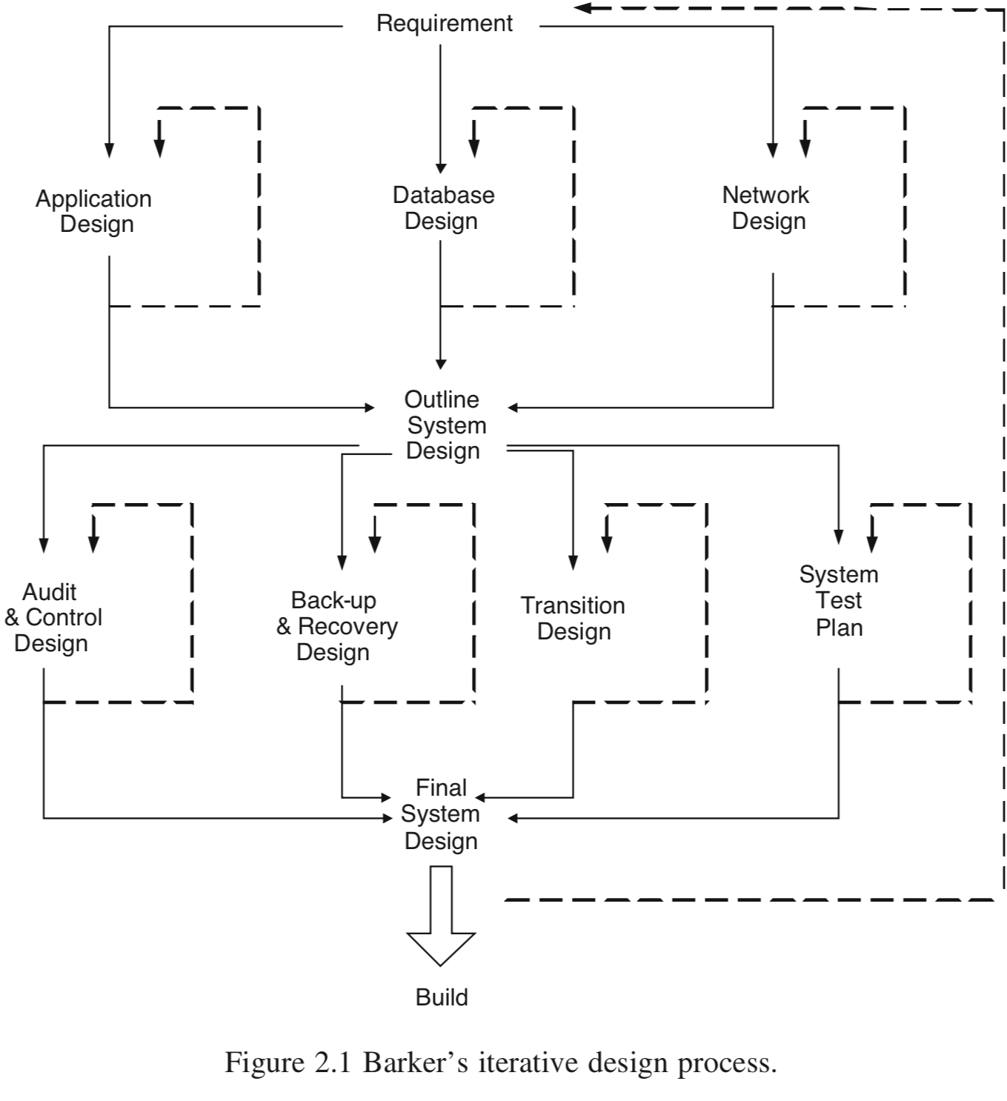
Barker Method

Slide 27
Systems Development Concepts
A process for creating and maintaining information systems not only computer program
Computer program: three components (hardware, software, and data)
Information systems
Five components (hardware, software, data, procedures, and people)
Never off-the-shelf
Fit the business objective and user’s requirements
Maintenance information systems: fix the problem and adopt change

Slide 28
Scales of Information Systems
System Type | Description
Personal | Supports one person with limited set of requirements
Workgroup | Supports a group of people normally with a single application
Enterprise | Supports many workgroups with many different applications
Interenterprise | Supports many different organizations with many different cultures, different countries and heritages

Slide 29
Systems Development Challenges
Determining requirements
Estimating schedule and budget
Changing technology
Dis-economics of scale
As the development teams become larger, the average contribution per worker decreases
Brooks’s Law: adding more people to a late project makes the project later
Training and coordination

Slide 30
Types of System Development Methods
Four major methods
Systems Development Life Cycle (SDLC)
Rapid Application Development (RAD)
Object Oriented Development (OOD)
Extreme Programming (EP)
No single method works for all information systems

Slide 31
Systems Development Life Cycle
Classical approach
Five phases
System definition
Requirements analysis
Component design
Implementation
Maintenance
Problems

Slide 32
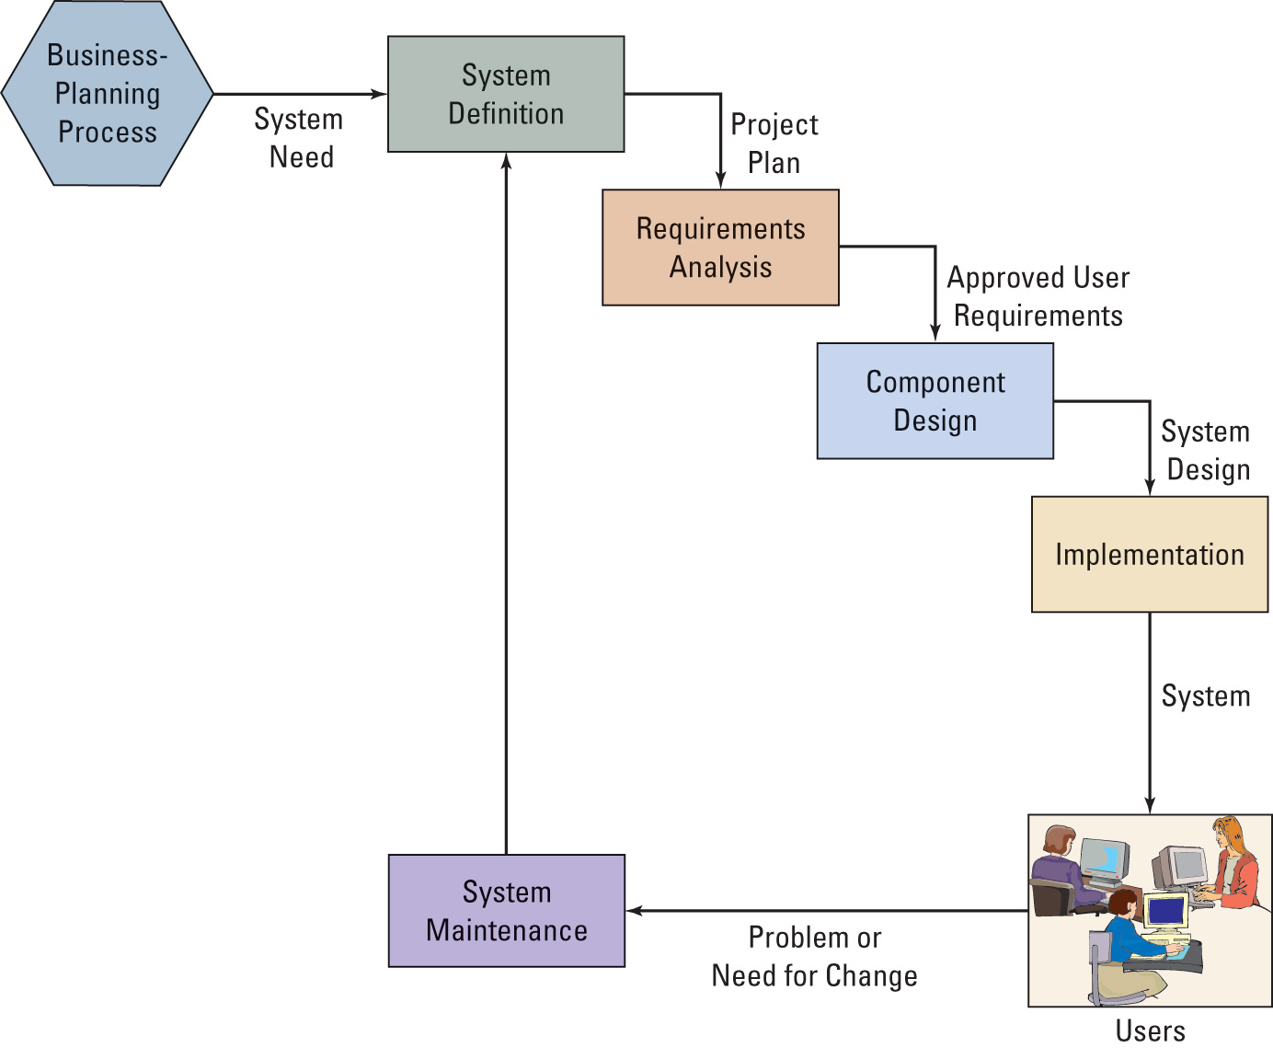
Five Phases in the SDLC

Slide 33
System Definition Phase
Define project
Goals and objectives
Scope–statement of work
Assess feasibility
Cost (budget)
Organizational (operational)
Schedule
Technical
Form a project team
Project manager
In-house IT staff
Outside consultants and staff (as needed)
User representatives (management and staff)

Slide 34
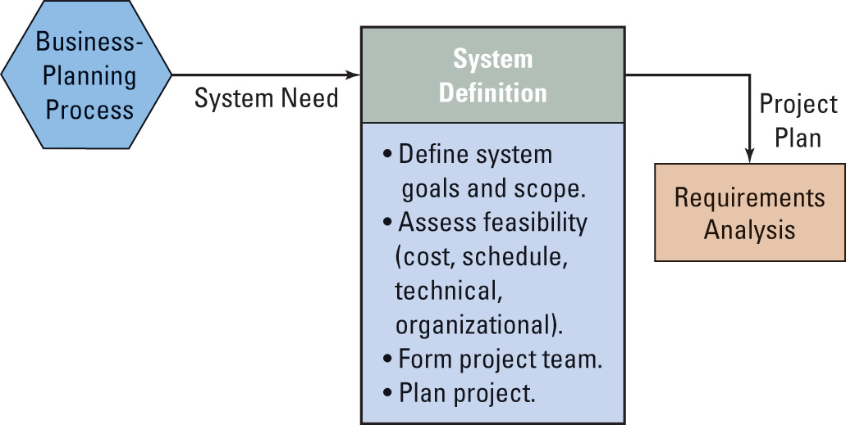
System Definition Phase

Slide 35
Requirement Analysis Phase
The most important phase
Conduct user interviews
Evaluate existing systems
Determine new forms/reports/queries
Identify new application features and functions
Consider security
Create data model
Develop requirements for the five components
Obtain user approval

Slide 36
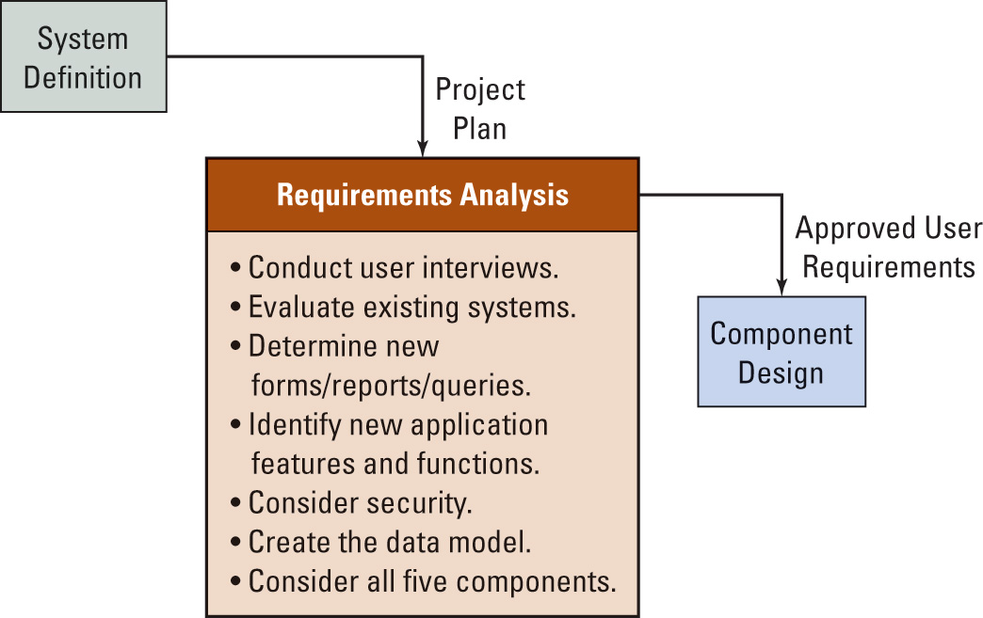
Requirements Analysis Phase

Slide 37
Component Design Phase
Design five components
Hardware specifications (processing computer and network)
Software specifications (source and code)
Create data model and database
Normal, backup, recovery for both user and operator
Job description of duty and responsibility for both user and operator
Determine alternatives
Evaluate each alternative against requirements
Select the best alternative that meets the requirements

Slide 38
Security Consideration
Users authentication
User groups
Primary system features and functions
System restrictions (minimum rights)
Permissions to user groups for specific features and functions

Slide 39
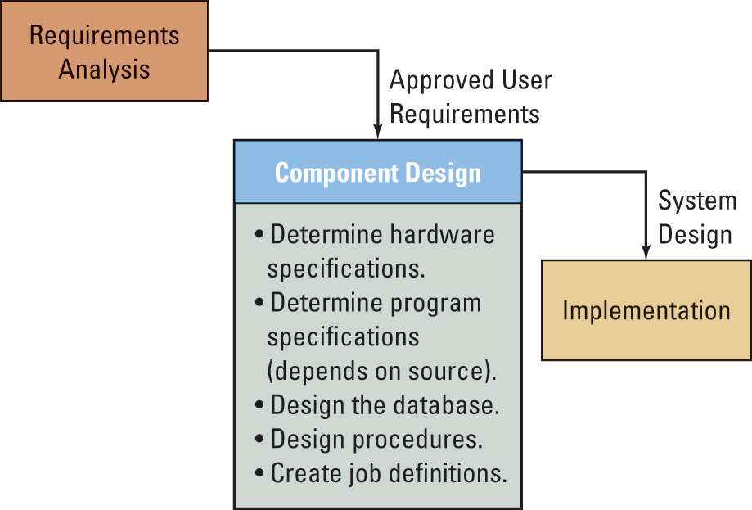
Component Design Phase

Slide 40
Implementation Phase - I
Build, test, and convert to the new system
User training document review and test procedures
System testing
Test plan
IT professional, user
Product quality assurance (PQA)
Normal and incorrect action
Beta testing

Slide 41
Implementation Phase - II
System conversion
Pilot: control negative impact
Phase
Parallel: save but expensive
Plunge (direct): new system only

Slide 42
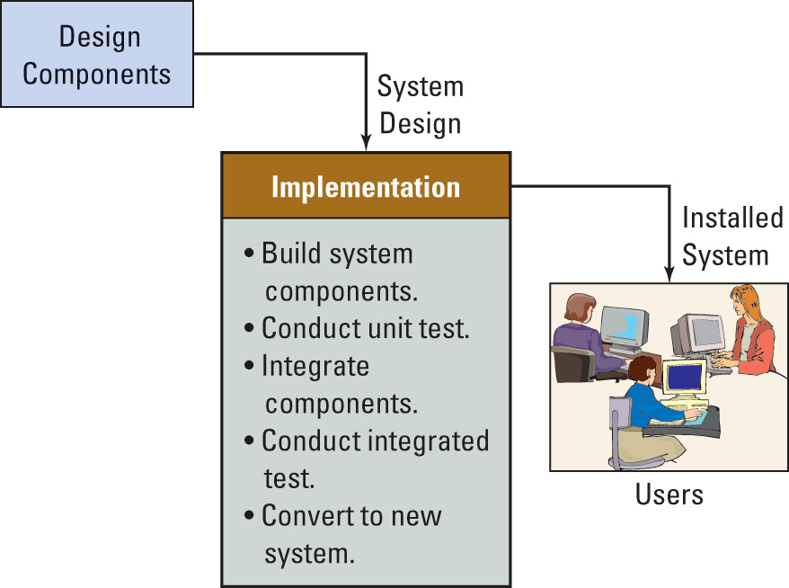
Implementation Phase

Slide 43
Maintenance Phase
Fixing the system to work correctly or adapting the system to changes in requirements
Tracking failure or enhancement requests for all five components
Prioritize requests
Fixing failures
Patch: high priority failures
Service pack: low priority failures
New release: major enhancements

Slide 44
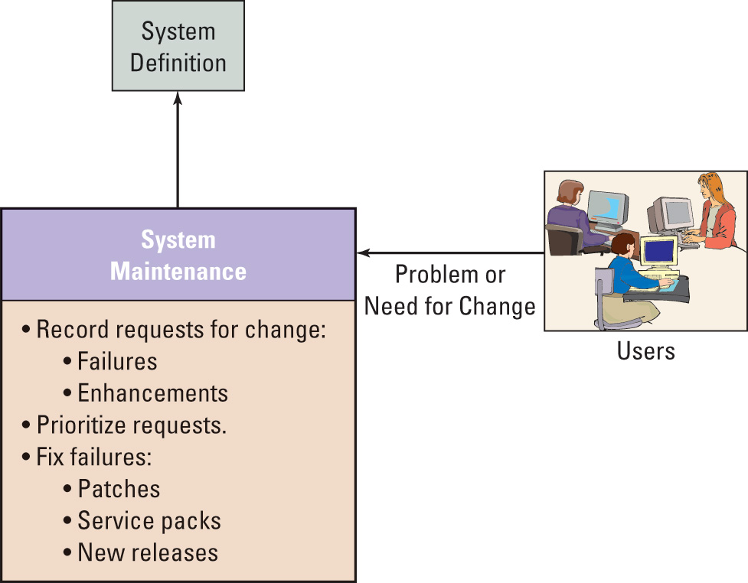
System Maintenance Phase

Slide 45
SDLC Problems
A need to crawl back up the waterfall
Unusable documenting requirements
Scheduling and budgeting difficulty

Slide 46
Rapid Application Development (RAD)
Proposed by James Martin
Characteristics
Break up the design and implementation phases of the SDLC into smaller pieces
Continuous user involvement
Prototype
Joint application design: user, developer and PQA personnel
Use CASE and visual development tools with repository and code generator (computer assisted software engineering or computer assisted systems engineering)

Slide 47
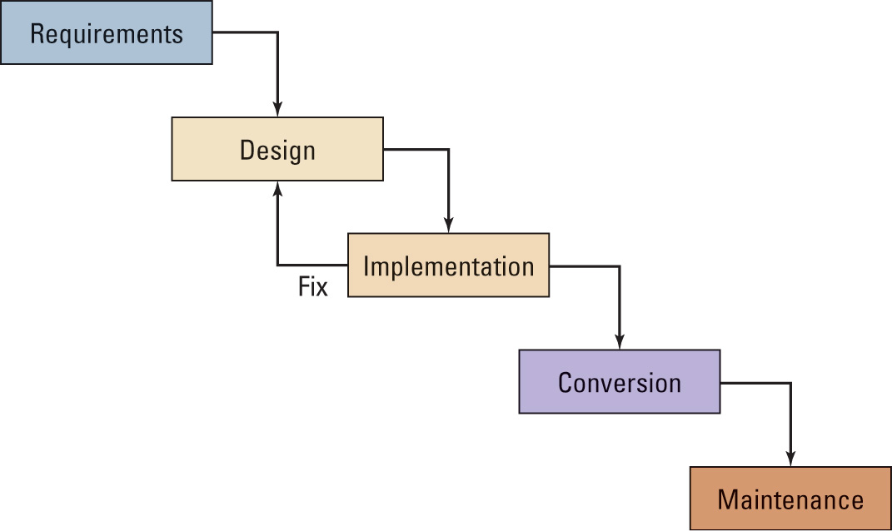
Martin’s RAD Process

Slide 48
Object Oriented Development
From discipline of object-oriented programming for designing and writing programs
Unified Modeling Language (UML): a series of diagramming techniques to facilitate OOP development
Unified Process (UP): for developing computer program not information systems with five phases
Inception phase: new system definition
Elaboration phase: construct and test the framework and architecture of most risk and uncertainty use case (requirement) for the new system (a description of an application of new system)
Construction phase: low risk features and functions use case (requirement)
Transition phase: conversion
Maintenance phase

Slide 49
UNIFIED PROCESS: FIVE PHASES
Inception phase: new system definition
Elaboration phase: construct and test the framework and architecture of most risk and uncertainty use case (requirement) for the new system (a description of an application of new system)
Construction phase: low risk features and functions use case (requirement)
Transition phase: conversion
Maintenance phase

Slide 50
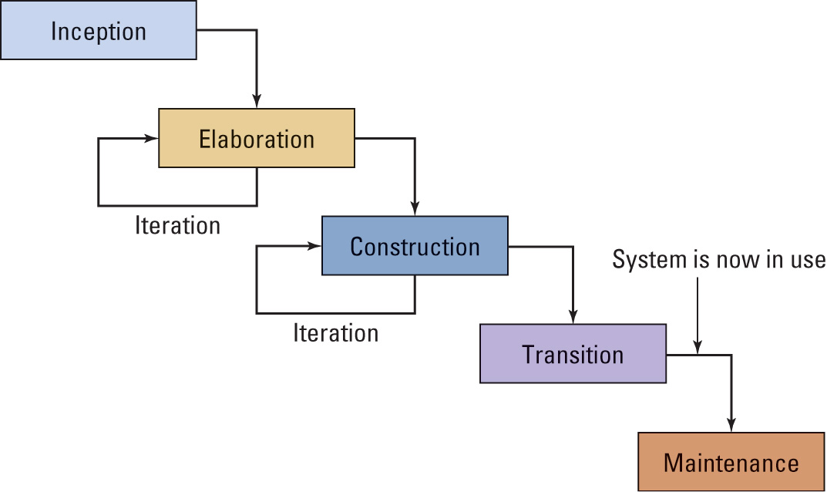
Stages in the Unified Process

Slide 51
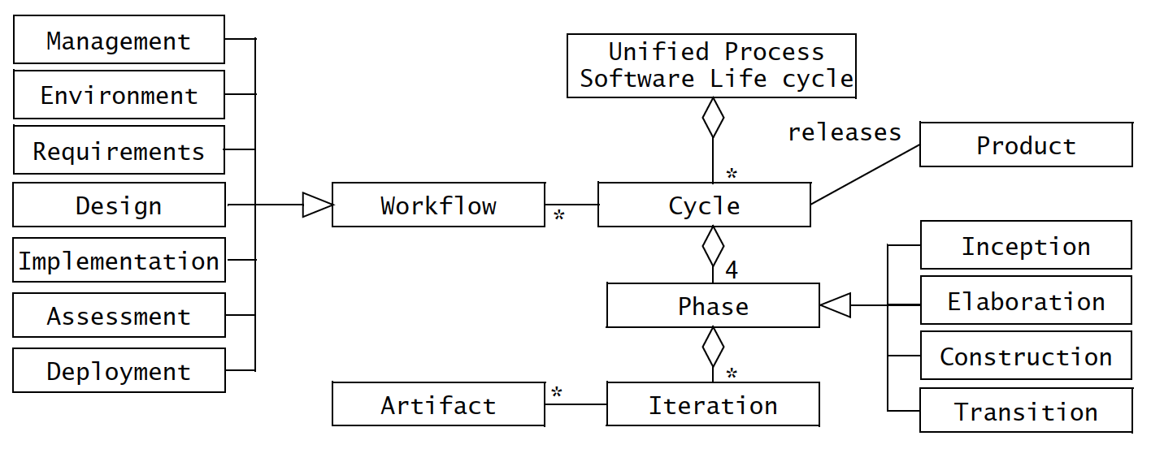
UNIFIED PROCESS - workflows

Slide 52
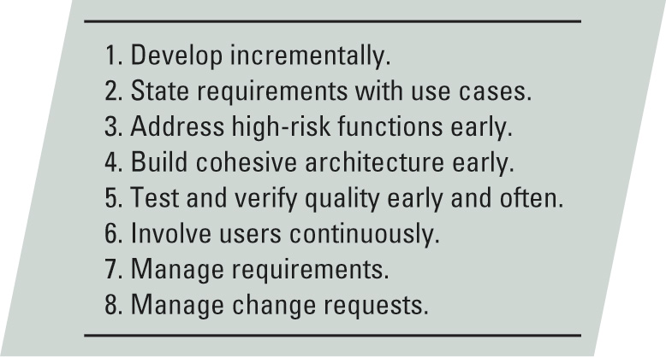
Unified Process Principles

Slide 53
Extreme Programming
An emerging technique for developing computer programs
Not useful for large scale development systems that require business processes and procedures
Characteristics
Customer centric (customer working full time in the development project
Just-in-time-design for programming
Paired programming to reduce error and maintaining effort

Slide 54
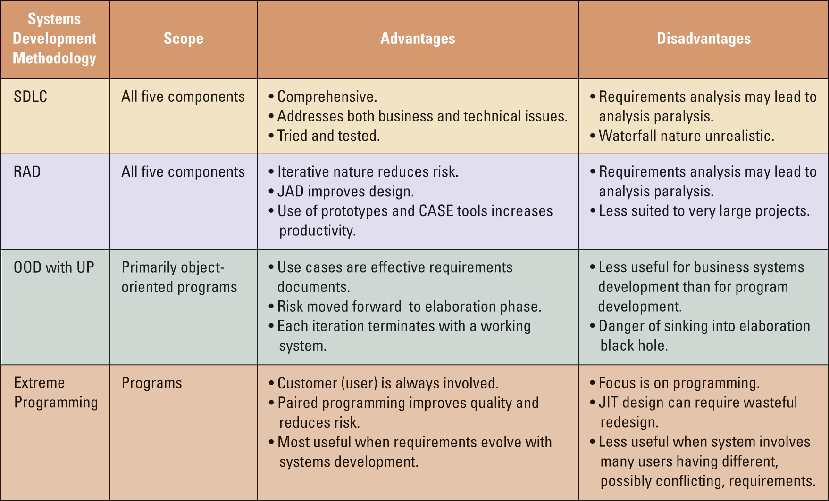
Comparison of Development Techniques

Slide 55
1.3. Managing Information System Project
References - - - - - - - - Modern Systems Analysis and Design, Joseph Valacich, Joey George, Pearson Education
Chapter - 3

Slide 56
Introduction
Project management (PM) may be the most important aspect of systems development.
Effective PM helps to ensure
The meeting of customer expectations.
The satisfying of budget and time constraints.
The nature of projects has changed from custom development to implementing packaged software and data warehousing.
PM skills are difficult and important to learn.

Slide 57
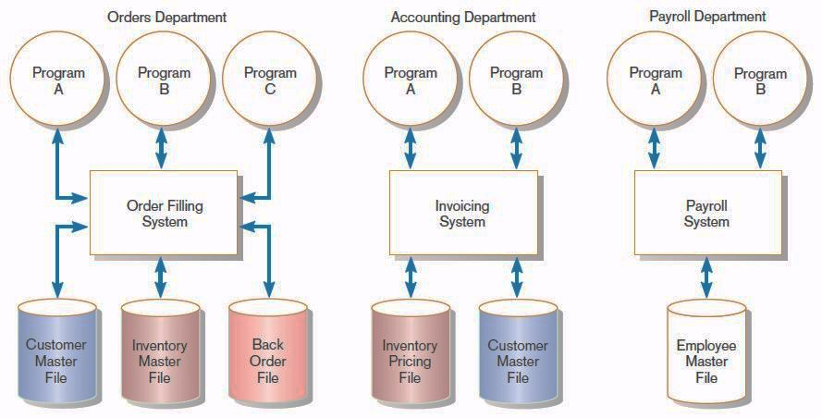
Pine Valley Application Project
FIGURE 3-1
Three computer applications at Pine Valley Furniture: order filling, invoicing, and payroll
Source: Hoffer, Ramesh, and Topi, 2011.

Slide 58
Managing the Information Systems Project
Project
A planned undertaking of related activities to reach an objective that has a beginning and an end
Project management
A controlled process of initiating, planning, executing, and closing down a project

Slide 59
Managing the Information Systems Project (cont.)
Project manager
A systems analyst with a diverse set of skills—management, leadership, technical, conflict management, and customer relationship—who is responsible for initiating, planning, executing, and closing down a project
Deliverable
The end product of an SDLC phase

Slide 60
Deciding on Systems Projects
System Service Request (SSR)
A standard form for requesting or proposing systems development work within an organization
Feasibility study
A study that determines whether a requested system makes economic and operational sense for an organization

Slide 61
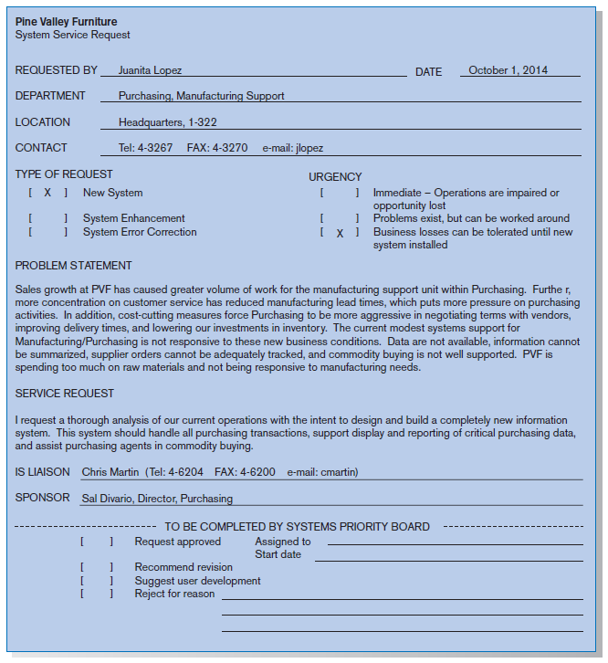
FIGURE 3-2
System Service Request for Purchasing Fulfillment System with name and contact information of the person requesting the system, a statement of the problem, and the name and contact information of the liaison and sponsor

Slide 62
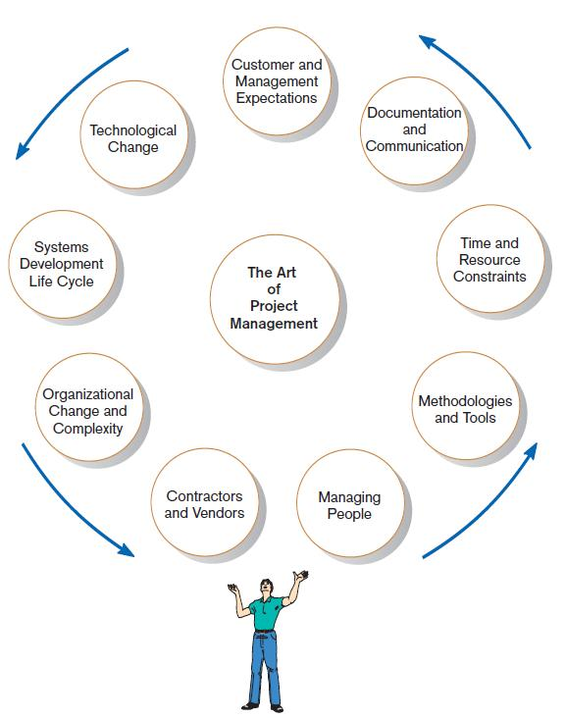
Project Management Activities
FIGURE 3-4
A project manager juggles numerous
activities

Slide 63
Phases of Project Management Process
Phase 1: Initiation
Phase 2: Planning
Phase 3: Execution
Phase 4: Closedown

Slide 64
PM Phase 1: Project Initiation
Assess size, scope and complexity, and establish procedures.
Establish:
Initiation team
Relationship with customer
Project initiation plan
Management procedures
Project management environment and workbook
Project charter

Slide 65
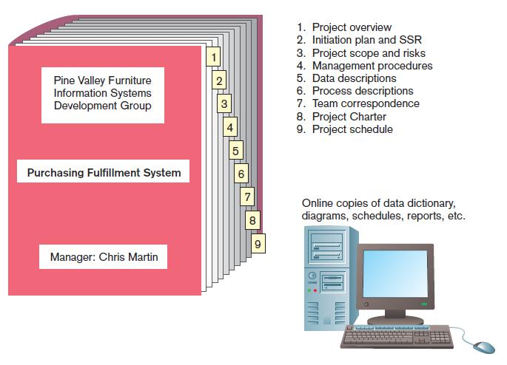
FIGURE 3-6
The project workbook for the Purchase Fulfillment System project contains nine key documents in both hard-copy and electronic form.

Slide 66
Project Charter
A short document prepared for the customer describing project deliverables and outlining the work required to complete the project
Elements:
Title and authorization date
Project manager name and contact information
Customer name and contact information
Project start and completion dates
Key stakeholders, roles, responsibilities
Project objectives and description
Key assumptions
Signatures of stakeholders

Slide 67
PM Phase 2: Project Planning
Define clear, discrete activities and the work needed to complete each activity. Tasks include:
Describing Project Scope, Alternatives, and Feasibility
Dividing the Project into Manageable Tasks
Estimating Resources and Creating a Resource Plan
Developing a Preliminary Schedule
Developing a Communication Plan
Determining Project Standards and Procedures
Identifying and Assessing Risk
Creating a Preliminary Budget
Developing a Project Scope Statement
Setting a Baseline Project Plan

Slide 68
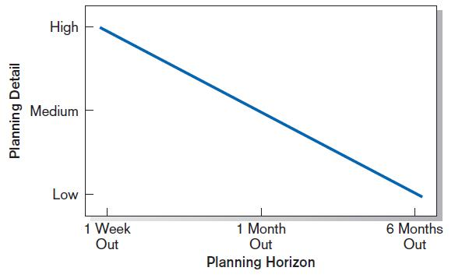
Planning Detail
FIGURE 3-8
Level of project planning detail should be high in the short term, with less detail as time goes on.

Slide 69
Project Scope, Alternatives, and Feasibility
What problem or opportunity does the project address?
What are the quantifiable results to be achieved?
What needs to be done?
How will success be measured?
How will we know when we are finished?

Slide 70
Dividing Project into Manageable Tasks
Work Breakdown Structure (WBS)
Division of project into manageable and logically ordered tasks and subtasks
Scheduling Diagrams
Gantt chart: horizontal bars represent task durations
Network diagram: boxes and links represent task dependencies

Slide 71
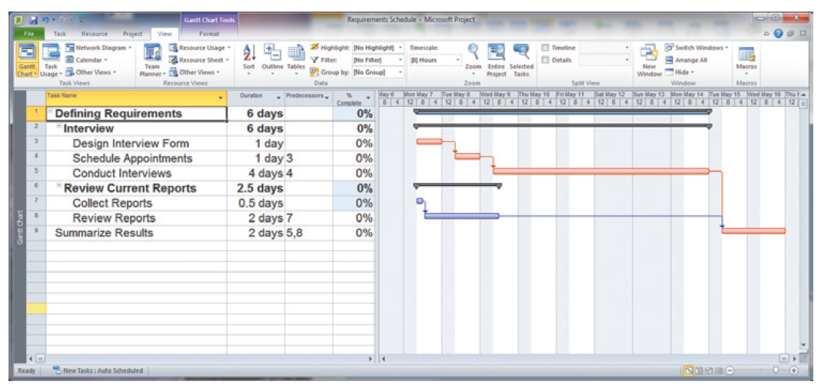
Developing a Preliminary Schedule
WBS
Gantt Chart
FIGURE 3-10
Gantt chart showing project tasks, duration times for those tasks, and predecessors

Slide 72
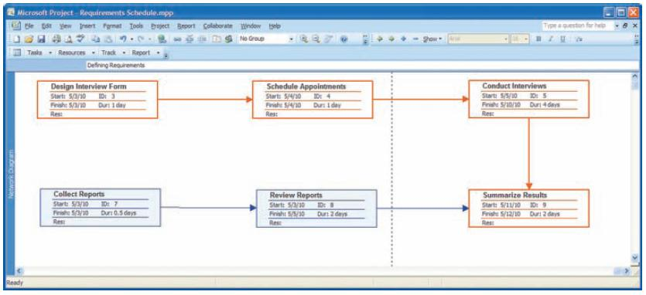
Scheduling Diagrams Network Diagram
FIGURE 3-13
A network diagram illustrating tasks with rectangles (or ovals) and the relationships and sequences of those activities with arrows (Source: Microsoft Corporation.)

Slide 73
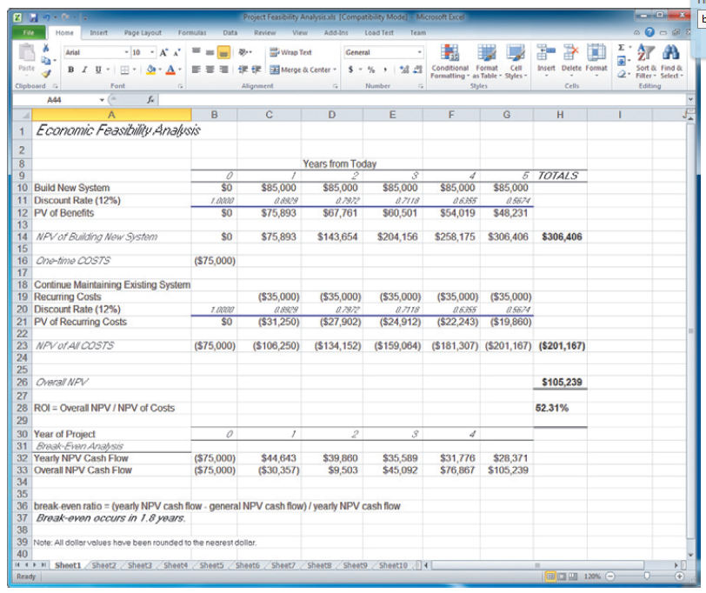
Developing a Preliminary Budget
FIGURE 3-15
A financial cost and benefit analysis for a systems development project (Source: Microsoft Corporation.)
Spreadsheet software is good for this.

Slide 74
Developing a Communication Plan
Who are stakeholders?
What information does each stakeholder need?
When should information be produced?
What are sources of information?
Who will collect, store and validate info?
Who will organize and document info?
Who is the contact person for each stakeholder?
What is the appropriate/best format for info?
What communication medium should be used?

Slide 75
Setting a Baseline Project Plan
A Baseline Project Plan provides an estimate of the project’s tasks and resource requirements and is used to guide the next project phase—execution. As new information is acquired during project execution, the baseline plan will continue to be updated.

Slide 76
PM Phase 3: Project Execution
Plans created in prior phases are put into action.
Actions
Execute baseline project plan.
Monitor progress against baseline plan.
Manage changes in baseline plan.
Maintain project workbook.
Communicate project status.

Slide 77
Monitoring Progress with a Gantt Chart
FIGURE 3-17
Gantt chart with tasks 3 and 7 completed and task 8 partially completed
Red bars indicate critical path; lines through bars indicate percent complete.

Slide 78
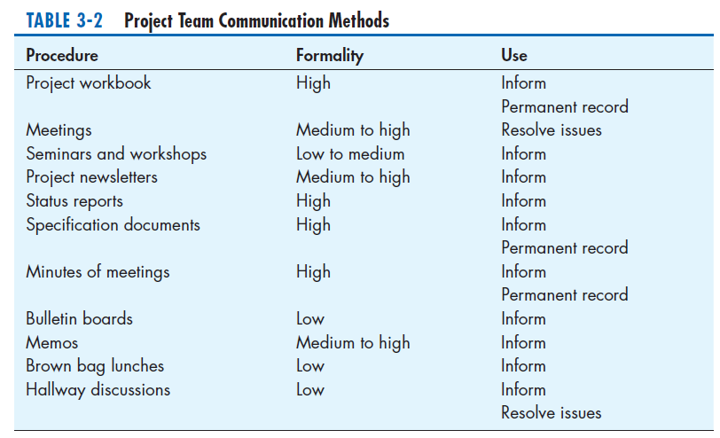
Communication Methods

Slide 79
PM Phase 4: Project Closedown
Bring the project to an end.
Actions
Close down the project.
Conduct post-project reviews.
Close the customer contract.

Slide 80
Representing and Scheduling Project Plans
Gantt Charts
Network Diagrams
PERT Calculations
Critical Path Scheduling
Project Management Software

Slide 81
Gantt Charts vs. Network Diagrams
Gantt charts
Show task durations.
Show time overlap.
Show slack time in duration.
Network diagrams
Show task dependencies.
Do not show time overlap, but show parallelism.
Show slack time in boxes.

Slide 82
Gantt Charts vs. Network Diagrams (Cont.)
Figure 3-19
Graphical diagrams that depict project plans
(a) A Gantt chart
(b) A network diagram

Slide 83
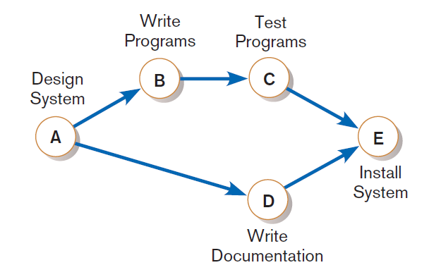
Gantt Charts vs. Network Diagrams (Cont.)
Figure 3-21
A network diagram showing activities
(represented by circles) and sequence of
those activities (represented by arrows)

Slide 84
Estimating Task Duration
PERT: Program Evaluation Review Technique
Technique that uses optimistic (o), pessimistic (p), and realistic (r) time estimates to determine expected task duration
Formula for Estimated Time:
ET = (o + 4r + p) / 6

Slide 85
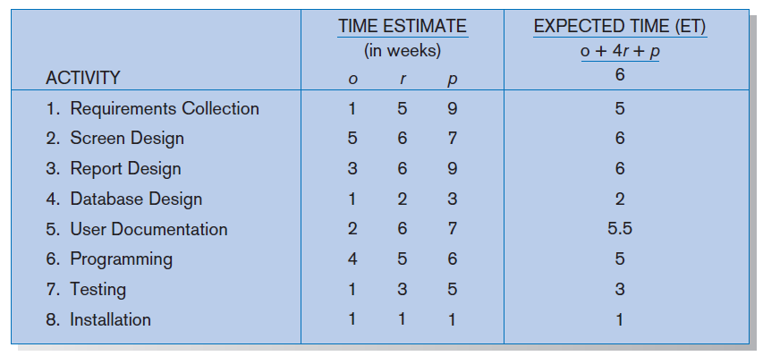
Example PERT Analysis
FIGURE 3-22
Estimated time calculations for the SPTS project

Slide 86
Critical Path Scheduling
A scheduling technique whose order and duration of a sequence of task activities directly affect the completion
Critical path: the shortest time in which a project can be completed
Slack time: the time an activity can be delayed without delaying the project

Slide 87
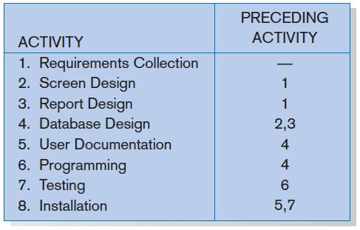
Critical Path Example (dependencies between tasks)
PRECEDING ACTIVITIES indicate the activities that must be completed before the specified activity can begin.
FIGURE 3-23 Sequence of Activities within the SPTS project

Slide 88
Critical Path Example (Cont.)
Figure 3-24
Gantt chart that illustrates the sequence
and duration of each activity of the SPTS
project

Slide 89
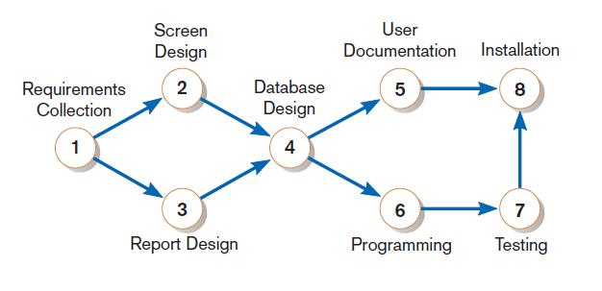
Critical Path Example (Cont.)
Network diagram shows dependencies
FIGURE 3-25
A network diagram that illustrates the activities (circles) and the sequence (arrows) of those activities

Slide 90
Determining the Critical Path
Calculate the earliest possible completion time for each activity by summing the activity times in the longest path to the activity. This gives total expected project time.
Calculate the latest possible completion time for each activity by subtracting the activity times in the path following the activity from the total expected time. This gives slack time for activities.
Critical path contains no activities with slack time.

Slide 91
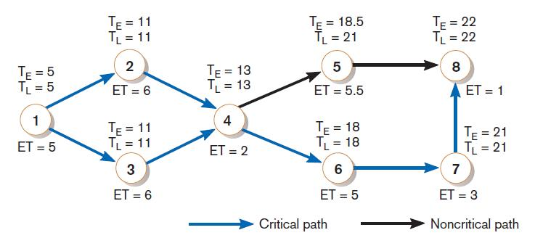
Critical Path Calculation
FIGURE 3-26
A network diagram for the SPTS project showing estimated times for each activity and the earliest and latest expected completion time for each activity
Early and late time calculations are determined and critical path established. (Note: Activity #5 can begin late without affecting project completion time.)

Slide 92
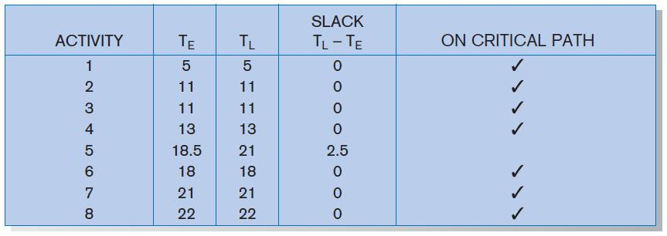
Critical Path Calculation (cont.)
FIGURE 3-27
Activity slack time calculations for the SPTS project; all activities except number 5 are on the critical path
Note the slack time in Activity #5.

Slide 93
Using Project Management Software
Many powerful software tools exist for assisting with project management.
Example: Microsoft Project can help with
Entering project start or end date.
Establishing tasks and task dependencies.
Viewing project information as Gantt or Network diagrams.

Slide 94
Summary
In this chapter you learned how to:
Explain the process of managing an information systems project.
Describe the skills required to be an effective project manager.
List and describe the skills and activities of a project manager during project initiation, project planning, project execution, and project closedown.
Explain what is meant by critical path scheduling and describe the process of creating Gantt charts and network diagrams.
Explain how commercial project management software packages can be used to assist in representing and managing project schedules.

Slide 95
Discussion on Nepali Scenario

